Slide 1

Prediction of Health insurance premium cost with IBM auto Ai service

Slide 2

TEAM MEMBERS
P. PREETHI (18UK1A0593)
MD.MAQSOOD ALI (18UK1A0587)
K.SADA PRIYAN(18UK1A05E5)
K.VENKATESH (18UK1A0581)

Slide 3
CONTENTS
ABSTRACT
OBJECTIVES
MOTIVATION
ARCHITECTURE & IMPLEMENTATION
CONCLUSION

Slide 4
ABSTRACT
As we see the value of gross insurance premiums worldwide continue to skyrocket past 5 trillion dollars, we know that most of these costs are preventable. For example, just by eliminating smoking and lowering your BMI by a few points might mean shaving thousands of dollars from your premium charges. In this application, we study the effects of age, smoking, BMI, gender, and region to determine how much of a difference these factors can make on your insurance premium. By using our application, customers see the radical difference their lifestyle choices make on their insurance charges. By leveraging artificial intelligence (AI) and machine learning, we help customers understand just how much smoking increases their premium by predicting how much they will have to pay within seconds.

Slide 5

OBJECTIVES
IBM Watson machine Learning architecture and services.
Training models and deploying machine learning models and neural networks.
Open source platform based on Kubernetes and Docker components.
It manage machine learning and Deep learning models.

Slide 6

MOTIVATION
As we see the value of gross insurance premiums worldwide continue to skyrocket past 5 trillion dollars.
Customers see the radical difference their lifestyle choices make on their insurance charges.
Predicting how much they will pay within seconds.

Slide 7
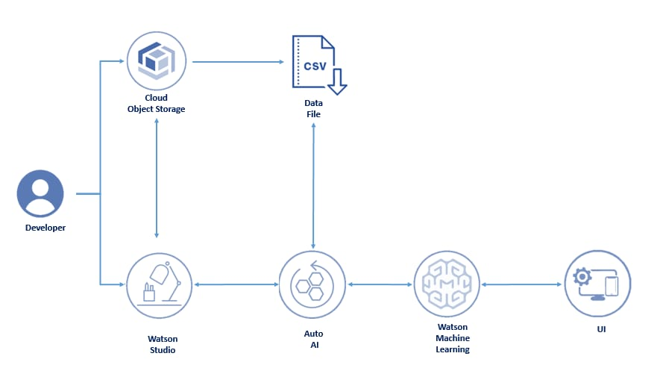
ARCHITECTURE

Slide 8

IMPLEMENTATION
Auto AI
Auto AI is a variation of Auto ML. It extends the automation of model building to the entire AI lifecycle.
Like Auto ML, Auto AI applies intelligent automation to the steps of building predictive machine learning models.
The best performing pipelines can be put into production to process new data and deliver predictions based on the model training.

Slide 9
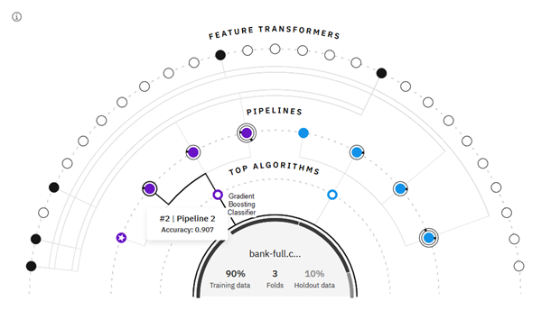
Auto AI

Slide 10
CONCLUSION
Using IBM Auto AI, we automate all of the tasks involved in building predictive models for different requirements. You see how Auto AI generates great models quickly, which saves time and effort, and aids in a faster decision-making process. As we see the value of gross insurance premiums worldwide continue to skyrocket past 5 trillion dollars, we know that most of these costs are preventable. For example, just by eliminating smoking and lowering your BMI by a few points might mean shaving thousands of dollars from your premium charges. In this application, we study the effects of age, smoking, BMI, gender, and region to determine how much of a difference these factors can make on your insurance premium. By using our application, customers see the radical difference their lifestyle choices make on their insurance charges. By leveraging artificial intelligence (AI) and machine learning, we help customers understand just how much smoking increases their premium by predicting how much they will have to pay within seconds.

